Slide 1

CAPSTONE PROJECT
Intelligent classification of rural infrastructure
Presented By:
Student Name-Shravan Sambhaji Mole
College Name-MIT Academy Of Engineering
Department-Computer Engineering

Slide 2
OUTLINE
Problem Statement (Should not include solution)
Proposed System/Solution
System Development Approach (Technology Used)
Algorithm & Deployment
Result (Output Image)
Conclusion
Future Scope
References

Slide 3
Problem Statement
Rural infrastructure projects encompass diverse initiatives such as roads, water supply, sanitation, irrigation, and electrification. These projects often vary widely in scope, impact, and urgency. Traditional classification methods are manual, inconsistent, and lack real-time adaptability. This leads to delays, misallocation of resources, and inefficiencies in planning and implementation. Intelligent classification using data-driven techniques is crucial for prioritizing projects, optimizing funding, and ensuring sustainable rural development.

Slide 4
Proposed Solution
The proposed system leverages machine learning techniques deployed on IBM Cloud Lite services to automatically classify rural road and bridge construction projects under the appropriate PMGSY scheme (e.g., PMGSY-I, PMGSY-II, RCPLWEA).
The system analyzes key physical and financial characteristics of each project using a supervised learning approach to improve accuracy, consistency, and scalability over manual classification.
Key Components:
Data Collection
Uses the AI Kosh dataset containing structured information on PMGSY projects.
Feature Extraction
Identifies relevant features (e.g., project length, cost, location, work type) from the dataset.
Model Training
Applies machine learning algorithms (e.g., Random Forest, SVM) to learn patterns from labeled data.
Automatic Classification
Predicts the correct PMGSY scheme for new or existing project entries based on learned patterns.
Cloud Deployment
Deploys the trained model using IBM Watson Studio, accessible via REST API for real-time classification.

Slide 5
System Approach
System Approach
The proposed system is designed to automatically classify rural infrastructure projects under various PMGSY schemes using machine learning, with deployment on IBM Cloud Lite services. The approach involves data preparation, model training, and real-time classification through cloud-based services.
1. System Requirements
To ensure smooth development, training, and deployment, the following IBM Cloud services are used:
a. IBM Cloud
Provides a scalable and secure platform to host the machine learning model
Ensures high availability and API-based access to classification services
b. IBM Watson Studio
Used to build, train, evaluate, and deploy the classification model
Offers Jupyter Notebooks, AutoAI, and visual tools for collaborative development
Supports version control and smooth deployment pipelines
c. IBM Cloud Object Storage
Stores the PMGSY dataset securely in CSV/JSON formats
Enables direct access and integration with Watson Studio for training and validation
Ensures scalability for handling large government datasets

Slide 6
Algorithm & Deployment
Algorithm and Deployment
🔹 Algorithm:
Model: Random Forest Classifier (or SVM based on accuracy)
Reason: Handles complex fault patterns and gives good performance on classification tasks.
🔹 Data Input:
Voltage, current, and phasor measurements
Taken from the provided labeled dataset
🔹 Training:
Supervised learning using labeled data
Fault types:
Normal
Line-to-Ground
Line-to-Line
Three-Phase
🔹 Deployment:
Model trained and deployed using IBM Watson Studio
Accessible via API endpoint for real-time predictions
Integrated with IBM Cloud Object Storage for dataset access

Slide 7
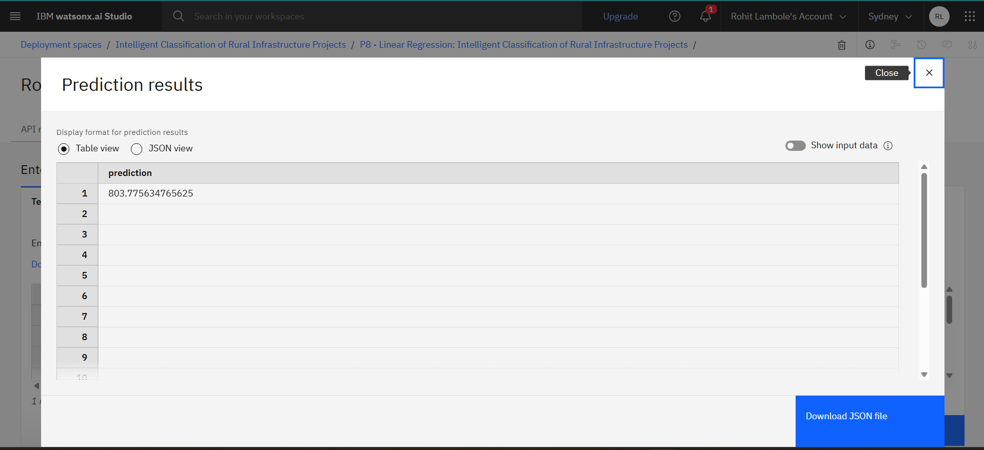
Result

Slide 8
Conclusion
The proposed machine learning model successfully automates the classification of PMGSY road and bridge projects based on physical and financial attributes. By deploying the solution on IBM Cloud Lite services, the system ensures scalability, real-time accessibility, and improved decision-making. This AI-driven approach reduces manual effort, enhances data accuracy, and supports better planning and monitoring of rural infrastructure under various PMGSY schemes.

Slide 9
Github Link:
https://github.com/shravan12092005/Intelligent-Classification-of-Rural-Infrastructure-Projects.git

Slide 10
Future scope
Future Scope
Extend model to transmission grid faults
Integrate real-time IoT sensor data
Use LSTM for better time-based predictions
Add predictive maintenance capabilities

Slide 11
References
IBM Cloud Documentation
IBM Corporation. IBM Cloud Lite Services and Watson Studio Documentation.
https://cloud.ibm.com/docs
Scikit-learn: Machine Learning in Python
Pedregosa, F. et al., Scikit-learn: Machine Learning Library.
TensorFlow: End-to-End Machine Learning Platform
TensorFlow Developers. Open Source ML Framework.
Government of India – PMGSY Scheme Overview
Ministry of Rural Development, Government of India.

Slide 12
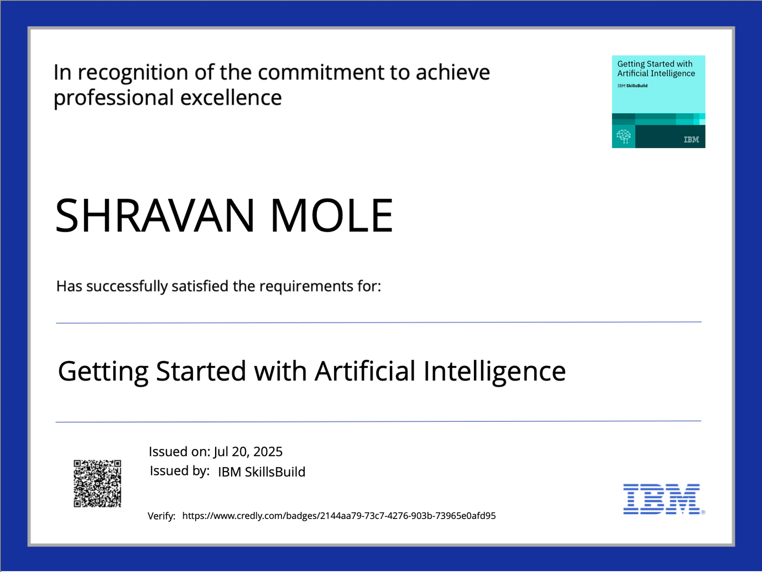
IBM Certifications

Slide 13

IBM Certifications

Slide 14
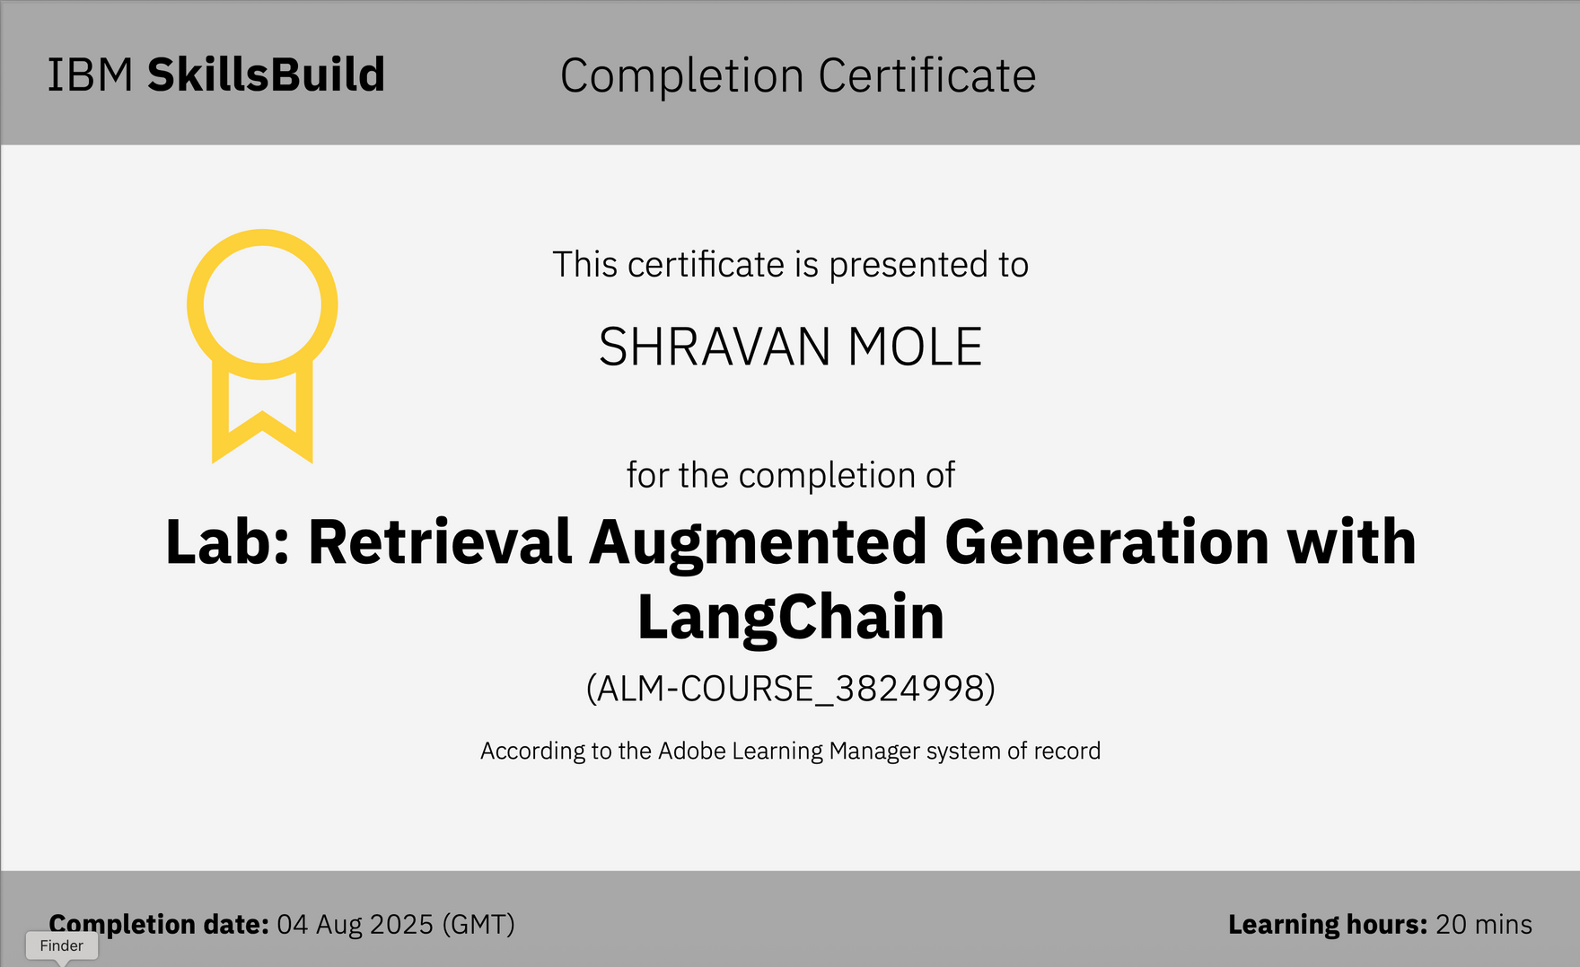
IBM Certifications

Slide 15
THANK YOU

